Slide 1





Data Science Salary Analysis
A Research Project By
Eshna Kundu

Slide 2
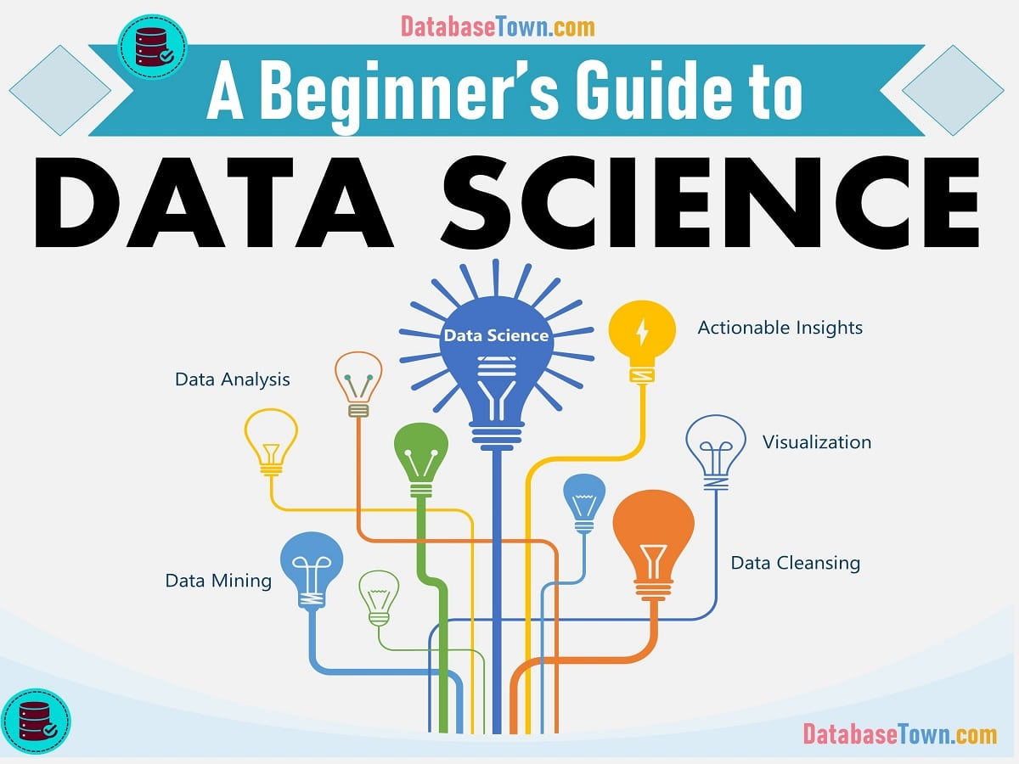

Data science is a deep study of the massive amount of data, which involves extracting meaningful insights from raw, structured, and unstructured data that is processed using the scientific method, different technologies, and algorithms..
An area that manages, manipulates,
extracts, and interprets knowledge from
tremendous amount of data
As a data scientist, we take a complex business problem, compile research from it, creating it into data, then use that data to solve the problem.

Slide 3

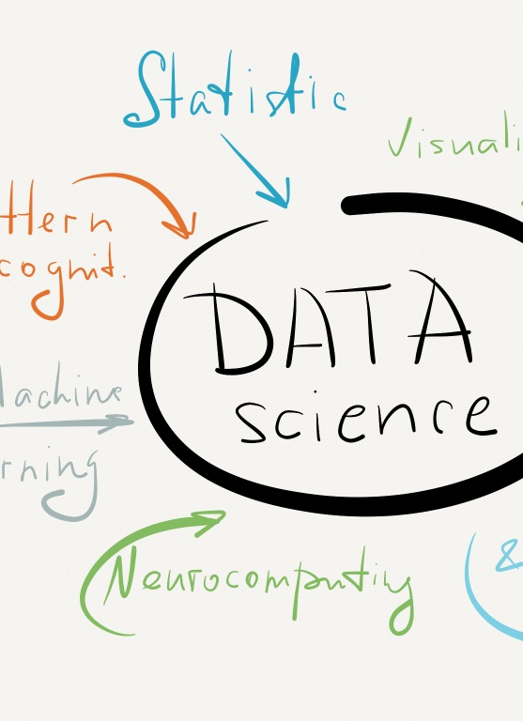
Data Set
Contains various data on a set of Job description , rating , Salary , location etc.
17 Unique Post as a data scientist.
38 unique variables.

Slide 4
Variables used
Variable
JOB TITLE | REVENUE
SALARY ESTIMATE | JOB LOCATION
JOB DESCRIPTION | AGE
RATING | NO.OF PEOPLE DID PYTHON,SQL,SPARK,EXCEL,AWS,HADOOP,TABLEAU,BI,
COMPANY NAME
TYPE OF OWNERSHIP
INDUSTRY

Slide 5

Objective of this case study is to analyze the Jobs available in the world as per Company ratings, Revenue (in Doller ),Job category.
Like, Python, Spark, AWS , etc.
Which category Job is in the highest trending state.

Slide 6
1. IDENTIFY STATE OR LOCATION WISE PERCENTAGE OF DATA SC.JOB ?
From the above chart we can see that CA, MA, NY’s location’s have the highest number of Jobs count as compared to other Location. This implies to us that these Job location are not very popular.

Slide 7
Find the top 10 company’s highest , lowest & average salaries with there job titles ?
From the above chart we can analyze that Principal Data Scientist, Senior Data scientist & Principal Machine learning Scientist have the highest paid average salary as compared to other post. This implies to us that these Job post are very popular along with their respective experiences.

Slide 8
Find the Industry wise revenue?
From the above chart we can analyze that industry wise revenue of different sectors like IT services & Enterprise Software & network solution have highest revenue whereas Motion Picture Production Distribution & other Retail Stores have been lowest revenue .

Slide 9
Ownership wise rating?
Asper the graph Shown, popular ownership rating implies between 3.30 to 3.37whereas lower ownership rating implies between 2.12 to 2.77.

Slide 10
Insight
Insight # 1
Insight # 2
As per the analysis ML Engineer, Data Scientist, and Data Engineer roles are getting higher salary package with avg. min. annual salary of $80K pa.
Insight #3
From the detailed analysis its reflecting that most of the companies have asked for Masters degree in their job descriptions.
Insight # 5
From the detailed analysis we can have a clear picture that according to company expectations, Python, SQL & EXCEL are the must have skills for any data science related role.
As per the analysis it is reflecting that
Seniority Level, Analytical Skills & tool expertise and Education background could be directly related to the salary distribution
Insight # 4
Data Scientist and Data Engineer are the most demanding and promising role in the emerging Data Science job market.

Slide 11
Thank you

